Slide 1
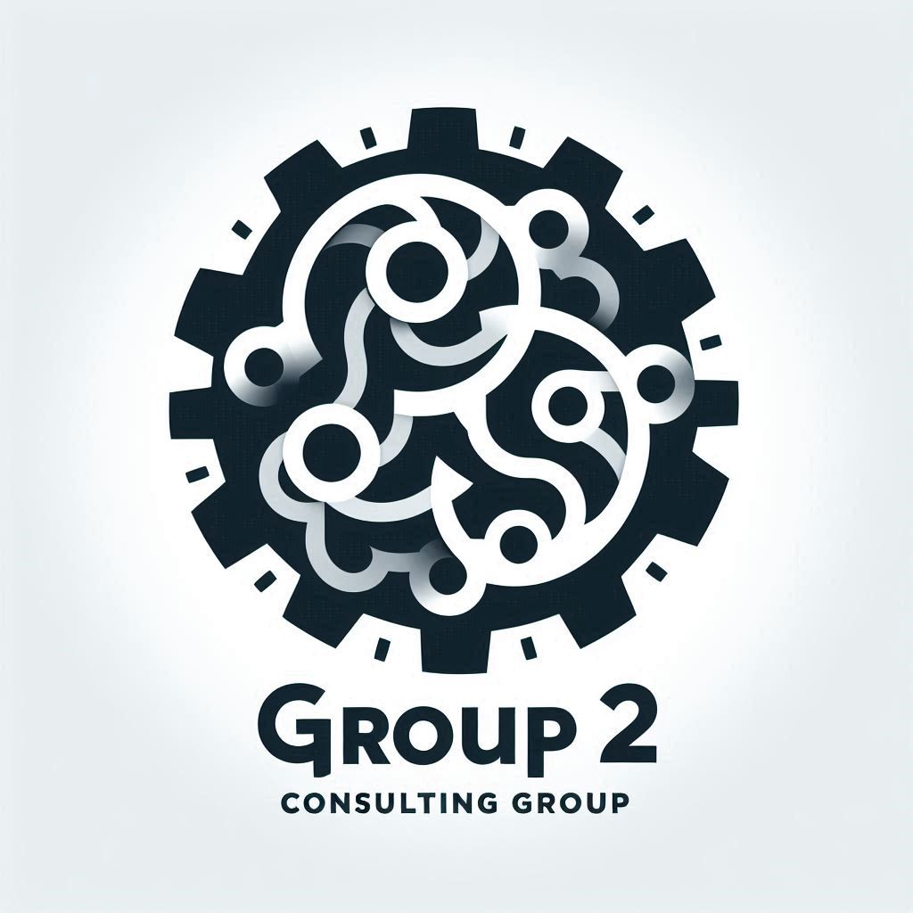
Modernizing IT Infrastructure with AWS Cloud Solutions
Client: TechStyle Inc.
CustomThread Project
JJTech Group 2 Consulting
…an AWS cloud solutions consultancy

Slide 2
Project Scope Revisit
Obinna
Project
CustomThread is looking to optimize and modernize its infrastructure and seeks to migrate from an on-premises setup to AWS Cloud. The primary goal is to improve performance, achieve PCI compliance, and reduce daily management efforts
Key Deliverables
Presentation of proposed solution – PowerPoint deck
Proposed architecture
Diagram
Components
Web Tier services and technologies
Database Tier services and technologies
Backup & Recovery strategies
Describe how architecture addresses client’s must-haves
Security Measures for both web and database tiers
How does measures achieve PCI compliance
Availability and Redundancy strategies
Cost Optimization measures
Client Must-Haves
Performance Optimization: application performs well during peak hours
Security and Compliance: Achieve PCI compliance; enhanced security
Scalability: Scalable architecture to handle future growth
Cost Optimization: Must be a cost-efficient solution
Low Maintenance: Requires minimal day-to-day management

Slide 3
Architecture Overview

Slide 4

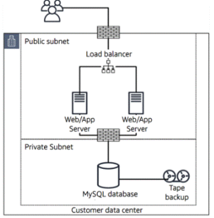





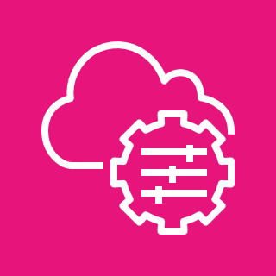












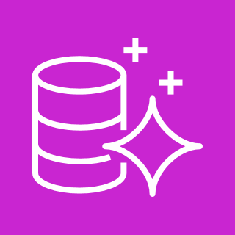
Proposed Solution: AWS 3-tier Architecture
Obinna
18
AWS Cloud
13
AWS
KMS
AWS Backup
11
17
Route 53
WAF
15
12
14
16
AWS SSM
CloudFront
Certificate Manager
From on-premises
To
AWS 3-tier
S3
3
Availability Zone 1
2
Availability Zone 2
1
VPC
Public subnet
Public subnet
NAT gateway
9
NAT gateway
4
Application
Load Balancer
Web / App subnet (private)
Web / App subnet (private)
Transition CustomThread infrastructure from on-premises to a 3-tier architecture in AWS.
This architecture will include:
VPC with multiple Availability Zones (AZs) for high availability; Private subnets for enhanced security
Right-sized EC2 instances based on workload history
AWS Application Load Balancer(ALB) for health checks, load balancing and ensuring traffic is directed only to healthy instances
Auto Scaling Group (ASG) to scale out during peak traffic and scale in during down times, maintaining optimal resource allocation
AWS Aurora database for 5X speed, automatic scaling, and multi-AZ replicas. This ensures fast failover and strong availability
Auto
Scaling
group
App servers
10
App servers
7
5
DB subnet (private)
DB subnet (private)
Memcached
Memcached
6
17
Amazon Aurora (primary)
Aurora Replica
(standby)

Slide 5
Description of Architecture Components
VPC with public and private subnets in 2 availability zones
Internet Gateway to allow communication between instances in VPC and internet
Two Availability Zones for high availability and fault tolerance
Public subnet to house resources like NAT gateway, Application Load Balancers and Bastion (we will replace bastion with SSM session manager)
App and DB servers will be placed in Private subnets
AWS Aurora with primary and replica mysql databases in different AZ to ensure high availability and resilience to failures
EC2 instances with the appropriate IAM roles and permissions to host web application
.
Application Load Balancer (ALB) to distribute traffic across an auto-scaling group of EC2 instances in multiple AZs.
Auto Scaling Group (ASG) to dynamically create EC2 instances to make web application highly available, scalable, fault-tolerant and elastic
Route 53 to set up DNS, direct traffic and domain management, and failover
CloudFront for global content caching, and SSL termination for data-in-transit encryption
WAF to protect application from web attacks that will compromise security consume resources and affect availability
Certificate Manager to create and manage the SSL/TSL encryption certification
Systems Manager to manage the resources – session manager for access (w/o need for ssh or bastion), patch manager for updates, etc
S3 to store static files, static website for failover, and back-up storage, and general storage
AWS Backup for S3 and DB

Slide 6
Implementing a 3-tier Architecture
Rufai
Tier Name | Tier Purpose | Interaction & Communication | Benefits of the 3-tier Architecture
Public Layer (public subnets) | Host internet-facing ALB Host NAT gateway Bastion Host (if client prefers this for SSH) | Public layer is isolated; Bastion host for SSH only | Enhanced scalability allowing independent scaling of each tier Improved security through isolation of resources in different tiers and control of data flow
Web / Application Tier (private subnets) | EC2 instances wrapped with ASG | Security Group opens SSH port for communication with Bastion
Database Tier (private subnets) | House AWS Aurora DB Multi-AZ for replication and automatic Failover | Security Group rules allow Web tier access to DB tier

Slide 7
Benefits of Proposed Solution

Slide 8
Performance Optimization
Yvette
To ensure that this architecture solved the performance issues that CustomThread faced while working on-premise, the following tools have been incorporated into their cloud environment:
Amazon Aurora: 5x faster performance compared to MySQL, automatic scaling, and multi-AZ replicas. Ensures fast failover, and strong availability. Up to 15 read Replicas across multiple AZs for distributed and fast read operations
Amazon ElastiCache (Memcached): In-memory cache will improve read speeds and reduce database load by storing frequently accessed data, such as session and API responses.
CloudFront: AWS’s global Content Delivery Network (CDN) will reduce latency by caching content closer to users at edge locations worldwide.
Auto Scaling Group: Ensures that servers are dynamically adjusted based on traffic demand, maintaining performance during peak times while being cost-efficient with little to no manual intervention
Application Load Balancer: for health checks, load balancing, and ensuring traffic is directed only to healthy instances.

Slide 9
Security and PCI Compliance
Leonard
Solution must enable client achieve PCI compliance.
VPC Isolation: Web, application, and database tiers are placed in private subnets, with strict access rules enforced by security groups and network ACLs.
IAM Access Control and MFA: Principle of Least Privilege to grant users (users and groups) and services (roles) only necessary permissions to perform their functions
SSL/TLS Encryption: AWS Certificate Manager will be used for managing SSL certificates, ensuring all data in transit is encrypted, meeting PCI DSS standards.
Data-at-Rest Encryption: Services like S3, Aurora, and EBS will have encryption enabled, utilizing AWS Key Management Service (KMS) to encrypt sensitive customer and payment data.
Amazon Macie: to fully manage data security and data privacy services using ML to discover, classify and protect sensitive data such as cardholder information in AWS.
AWS System Manager (SSM): SSM’s patch manager to automate patch updates for vulnerability management
WAF (Web Application Firewall) and AWS Shield: These will be implemented to protect against DDoS attacks and application-level threats like SQL injections, improving both compliance and security.

Slide 10
High Availability and Redundancy
Precious
Solution must be highly available, resilient and fault tolerant
Multi-AZ Setup: AWS’s infrastructure is set up across multiple availability zones, ensuring redundancy. This ensures that even if one zone fails, traffic is redirected to a healthy zone, maintaining service availability.
Automatic Failover with Aurora: Aurora's automatic failover ensures that, in the event of a primary database failure, a replica is promoted to minimize downtime.
AWS Backup: Provides automatic backups of S3 data, and databases, stored redundantly across multiple AZs to ensure high availability and reliability of backups.

Slide 11
Scalability
Adaobi
In anticipation of future growth, solution must be natively scalable
VPC Scalability with new subnets: Easily add new subnets to company's existing VPC to accommodate additional resources and services.
Compute Scalability with Auto Scaling Group (ASG): Ensures that the application can handle fluctuating workloads by automatically scaling in or out based on traffic demand. This provides elasticity, maintaining performance without manual intervention.
Database Scalability with Aurora: Aurora allows for read scaling by adding replicas, and storage will automatically increase as needed.
Storage Scalability with AWS S3 Storage: The solution can scale indefinitely, allowing CustomThread to store an unlimited amount of customer data, media, and backups with lifecycle policies to optimize costs.
Serverless Scalability: AWS Lambda and other serverless options offer automatic scaling to accommodate any level of demand without server management

Slide 12
Cost Optimization
Kingsley
Migration to AWS Cloud must demonstrate consideration cost improvement for CustomThread
Reserved Instances and On-Demand Instances: By reserving a portion of EC2 instances and using on-demand instances during traffic spikes, the client can save up to 75% on costs compared to a purely on-demand model.
S3 Lifecycle Policies: These will manage data across storage tiers, ensuring cost-efficient long-term data storage.
AWS Cost Explorer and Budgets: These tools will provide visibility into spending, allowing the team to set budgets and track cost trends.

Slide 13
Low Maintenance
Leslie
AWS managed services are key to automation and hand-off management
AWS Backup offer automatic backups with retention policies
Amazon Aurora offer automatic replication, automatic failover, and scaling, minimizing manual intervention
AWS Systems Manager (SSM): helps manage and automate operational tasks such as patch management, access control (via Session Manager without the need for manual SSH or bastion hosts), and maintenance tasks
Automated Monitoring and Alerts: Using CloudWatch and CloudTrail, performance metrics, and API calls are monitored, and automated alerts are configured to notify the team of any performance or security issues. Lambda functions can automate responses to critical alarms
AWS CloudFormation automates provisioning, management, deployment and retirement of resources
Cost Explorer enables automatic tracking of costs and budgets via

Slide 14
Backup and Recovery
Alain
Several embedded Backup and Recovery services in AWS allow for better management of disaster recovery
Backup
AWS Backup: fully managed service that centralizes and automates the backup of AWS services such as EBS volumes, EC2 and RDS volumes
S3 Versioning and Replication: including cross-region replication (CRR) ensuring redundancy and availability of data in disaster scenarios
Aurora Global Databases: Amazon Aurora’s Global Database feature replicates data across multiple AWS Regions.
Recovery
Backup and Restore
Pilot Light
Warm Standby
Multi-site Actie-Active

Slide 15
Summary
Obinna
18
AWS Cloud
13
AWS
KMS
AWS Backup
11
17
Route 53
WAF
15
12
14
16
AWS SSM
CloudFront
Certificate Manager
S3
3
Availability Zone 1
2
Availability Zone 2
1
VPC
Public subnet
Public subnet
NAT gateway
9
NAT gateway
4
Application
Load Balancer
App subnet (private)
App subnet (private)
Auto
Scaling
group
App servers
10
App servers
7
5
DB subnet (private)
DB subnet (private)
Memcached
Memcached
6
17
Amazon Aurora (primary)
Aurora Replica
(standby)

